Slide 2
World Class Digital Training for
IT Professionals

Slide 3
Housekeeping
Mobile phone
Emergencies / Fire Alarm
Breaks
Facilities & Toilets

Slide 4
ACTIVITY

Slide 5
About You
Please write down:
2 things that are true about you
2 things that are not true about you
Don’t tell each other which is which, share with everyone as if they are all true
The others will try to guess which are true and which is false

Slide 6
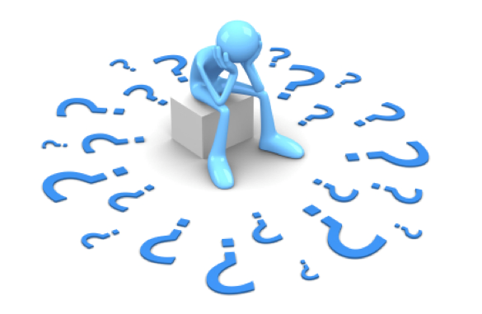
Questions?

Slide 7

Thank you
for attending this Session
&
Good Luck !

